Slide 1
付款函稿API

Slide 2
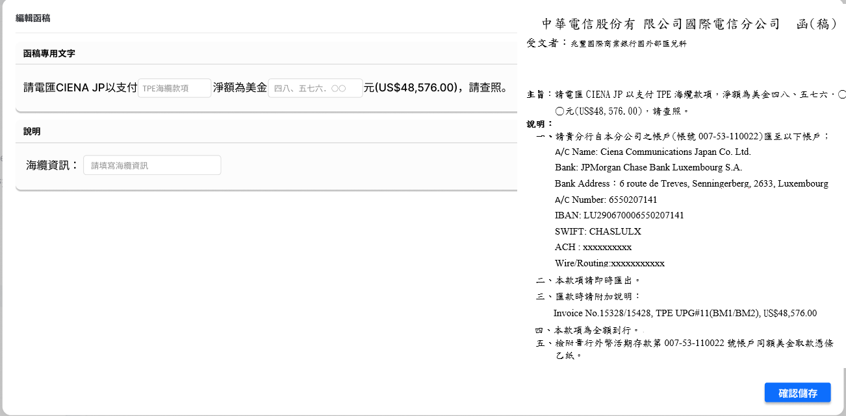
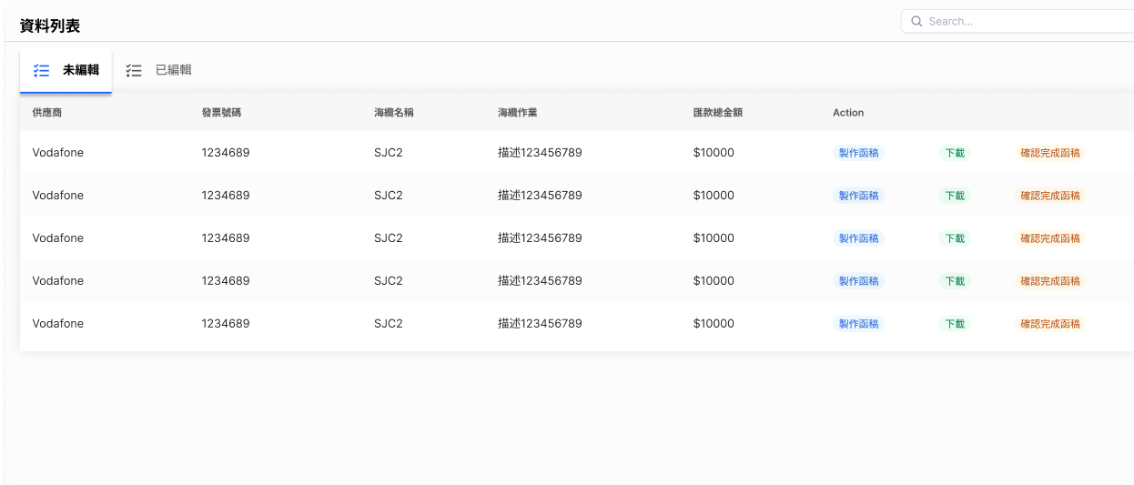
製作函稿API
Response:
{
"PayDraftID": 2(int),
"PayMID": 2(int),
"Payee": "字串",
"InvoiceNo": "字串",
"SubmarineCable": "字串",
"WorkTitle": "字串",
"CableInfo": "字串",
"TotalFeeAmount": 208494.52(float),
"Subject": "字串",
"Address": "字串",
"CtactPerson": "字串",
"Tel": "字串",
"email": "字串",
"IssueDate": "字串",
"IssueNo": "字串",
"OriginalTo": "字串",
"CBPBankAcctNo": "字串",
"BankAcctName": "字串",
"BankName": "字串",
"BankAddress": "字串",
"BankAcctNo": "字串",
"IBAN": "字串",
"SWIFTCode": "字串",
"ACHNo": "字串",
"WireRouting": "字串",
"Status": "TEMPORARY"(字串),
"PayeeType": "SUPPLIER"(字串),
"URI": ""
}
URL: http://10.193.130.8:8000/api/v1/getPayDraftStream
Method: POST
POST Body:
{
"PayDraftID": int,
"Preview": true
}
URL: http://10.193.130.8:8000/api/v1/getPayDraftStream
Method: POST
POST Body:
{
"PayDraftID": int,
"PayDraftChineseTotalFeeAmount": "中文數字",
"CableInfo" : "海纜資訊",
"Save": true
}

Slide 3
下載函稿API
URL: http://10.193.130.8:8000/api/v1/getPayDraftStream
Method: POST
POST Body:
{
"PayDraftID": int,
"DownloadTemplate": true
}

Slide 4
確認函稿API
URL: http://10.193.130.8:8000/api/v1/paydraft
Method: POST
POST Body:
{
"PayDraftID": int,
"Status": "COMPLETE",
}

